Slide 1

Linear Regression
Evolve Machine Learners
Notes:
https://techxplore.com/news/2018-02-google-ai-heart-disease-pictures.html

Slide 2
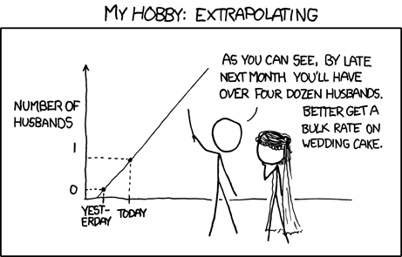


Slide 3
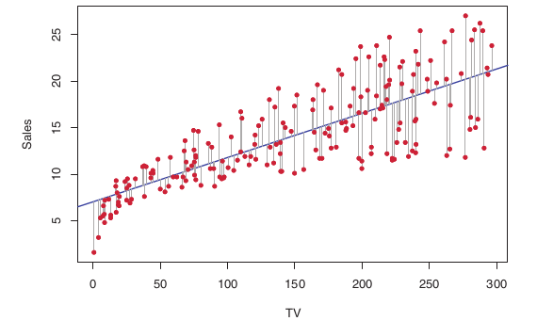
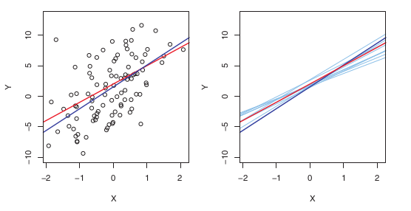

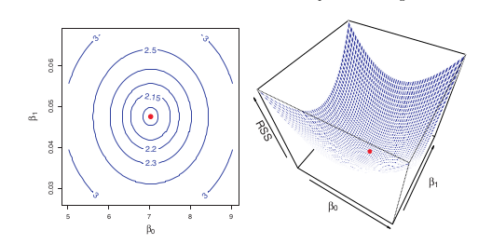

Slide 4
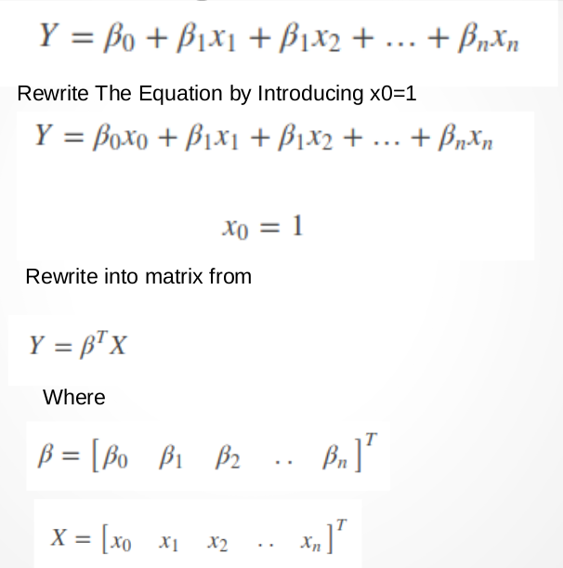
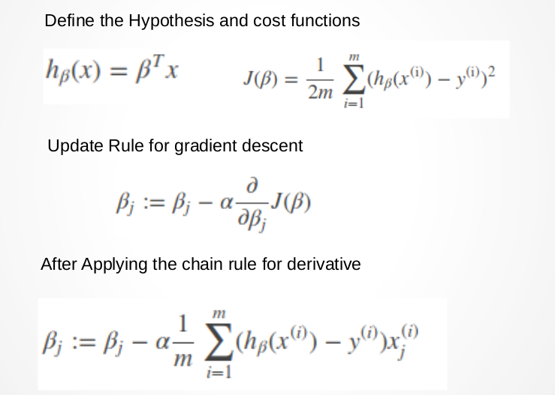


Slide 5
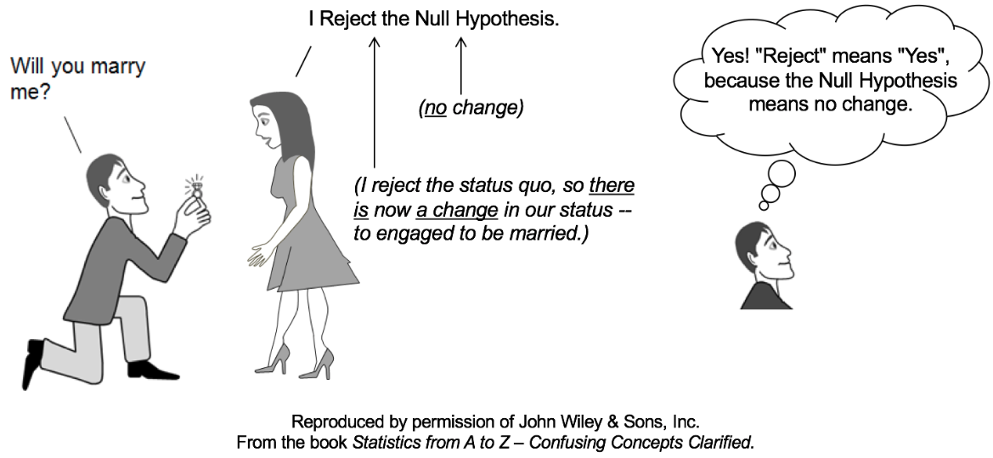


p(t) = p-value

Slide 6
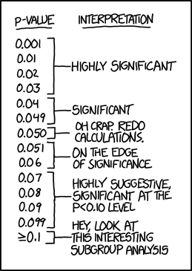
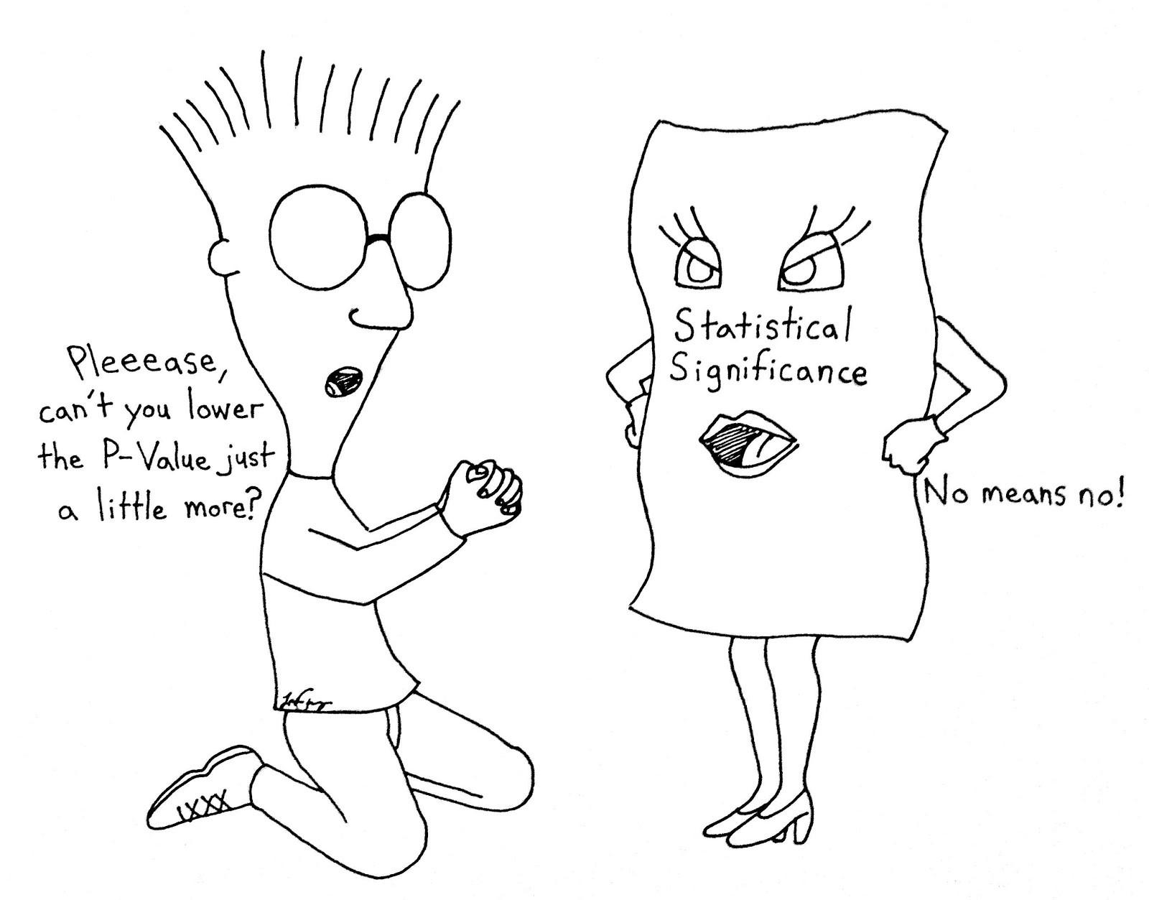
If p < 0.05 we can reject the Null Hypothesis!

Slide 7
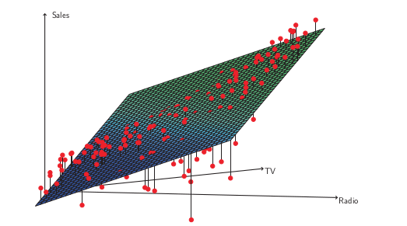
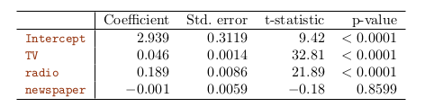

Slide 8
Assumptions
Linear Relationship
Additive
No correlation amongst error
Variance of error is constant
No outliers or high leverage points
Collinearity

Slide 9
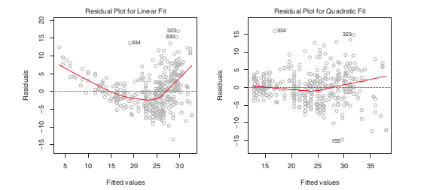
Linear Relationship
The X = log X or X^2 or X^½

Slide 10
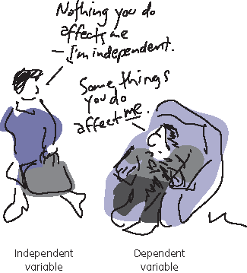



Additive
“Additive always assume each variable is indepent”

Slide 11


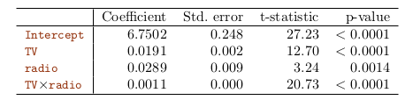
Don’t ignore the TV or radio!

Slide 12
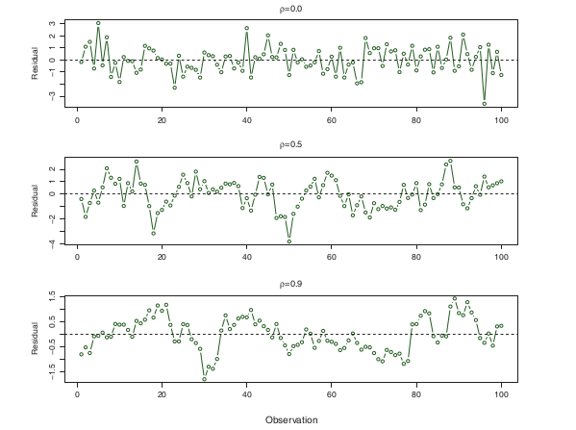
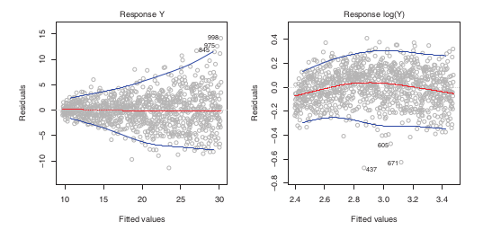
No Correlations and Constant Error Variance
Correlation
Variance

Slide 13
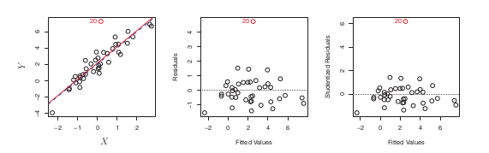
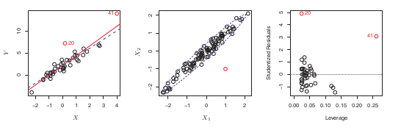

Outliers and High Leverage
Outliers
High Leverage

Slide 14
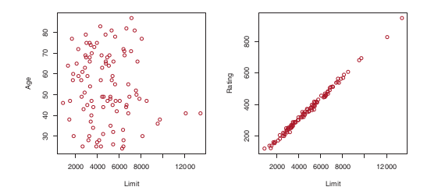

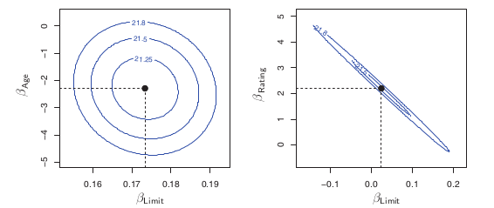
No Collinearity

Slide 15
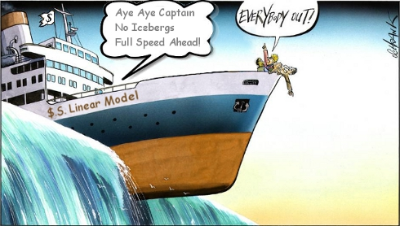
What happens with non-linear data?

Slide 16
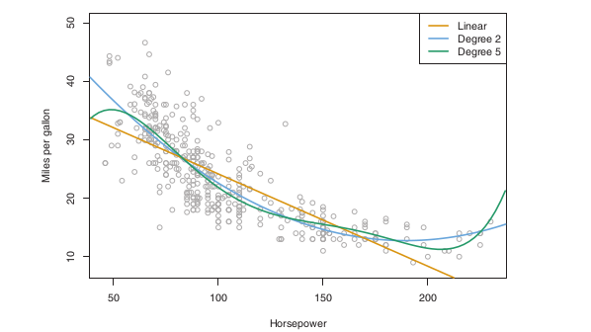



Slide 17


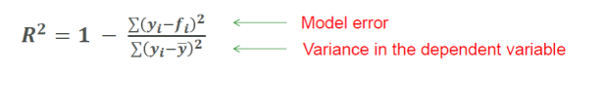
How to check if a model fit is good?
“R square measured how much percentage the variability of data explained by the model”

Slide 18
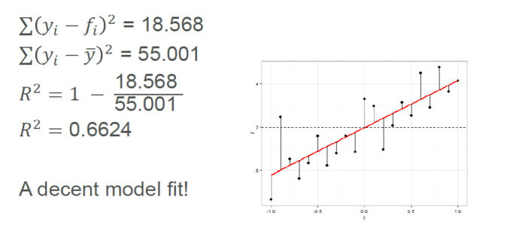
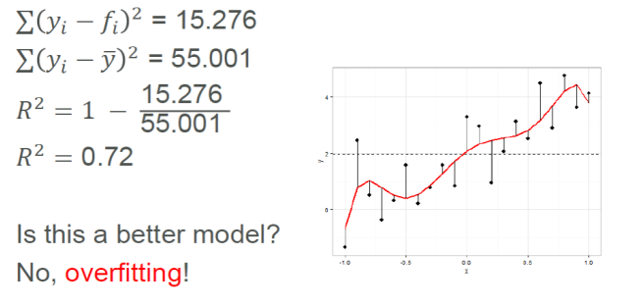

Slide 19
